Slide 1
Gaussian-based SBR Measurement
Github link

Slide 2
Idea
Signals are marked by a peak intensity
However, they can be decomposed into:
True Positive✔
False Positive✖

Slide 3
Spatial Information
Local peak Maximums
Key parameter: distance criteria – 2 spots cannot be closer than some x distance (x=15-20 pixels) minimize false positives

Slide 4
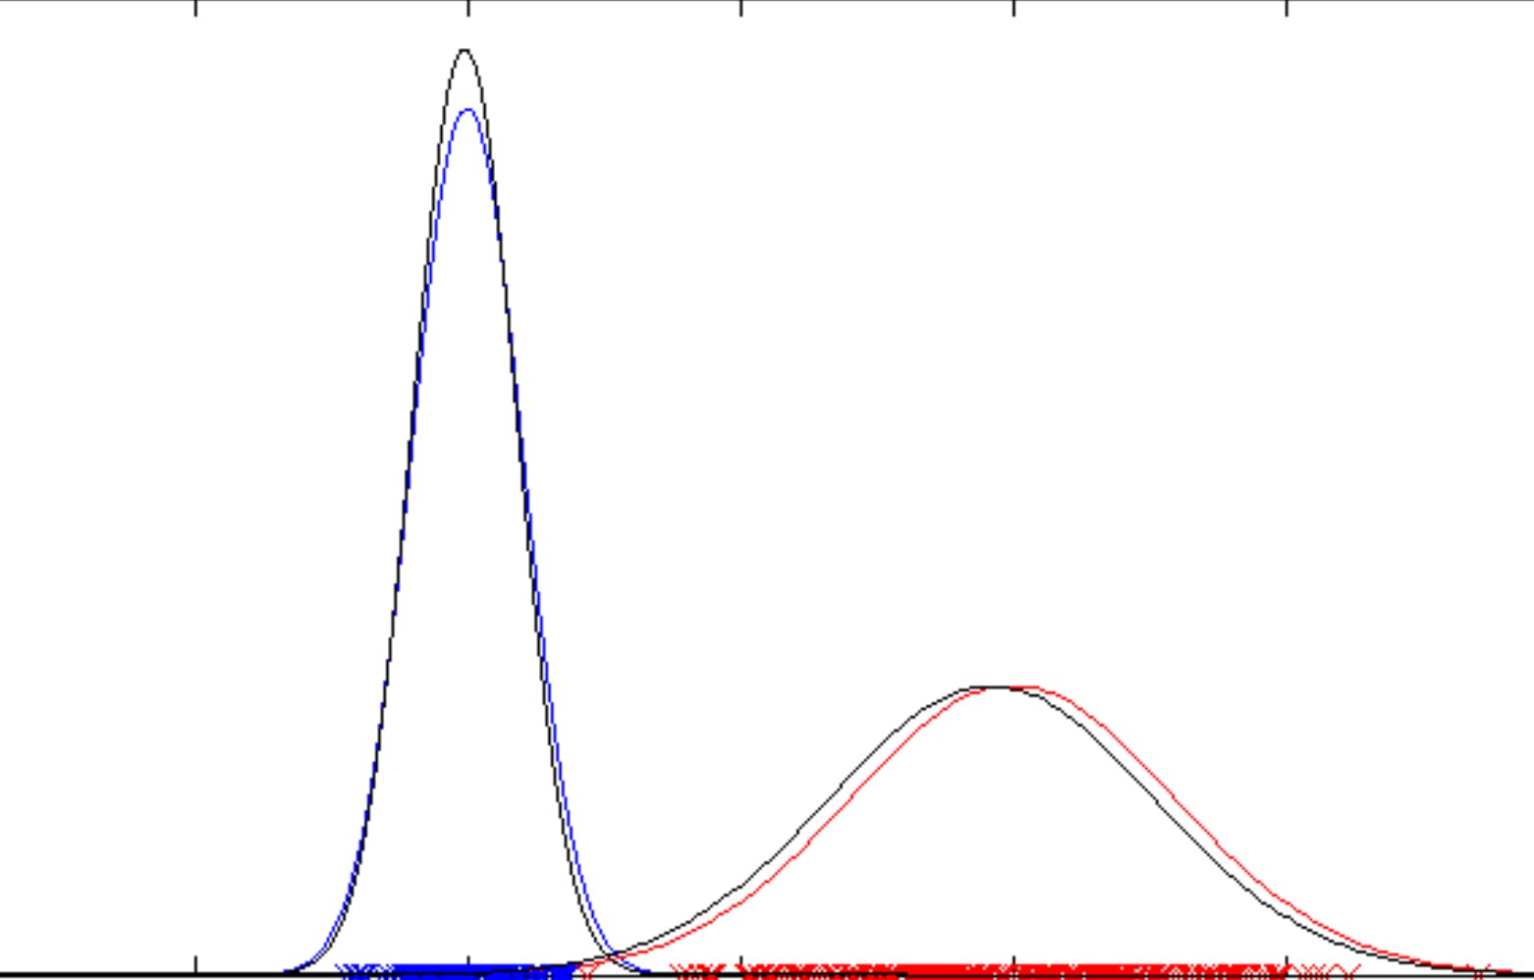
Intensity Information
Gaussian Mixture Model
Intercept (threshold)
Intensity Values
Bg
Signals
Undistinguishable signals

Slide 5
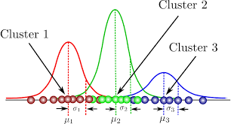
Montage/collage images thresholding
High background/ Artifacts
Similarly, the model can be fitted with more than 2 groups (k=3)
Used on collage image (stitch of all image) to provide auto-thresholding
Background
Signals
Intensity Values

Slide 6
Drawbacks
Low expression targets
Number of data points ↓ Reliability ↓
Maximas intensity too close to background
High gaussian curve overlap
Does not look at size/shape like people
Can be confused by very bright structures (i.e., Lipofuscin)
Not a problem if it is largely outnumbered by spots maximas

Slide 7
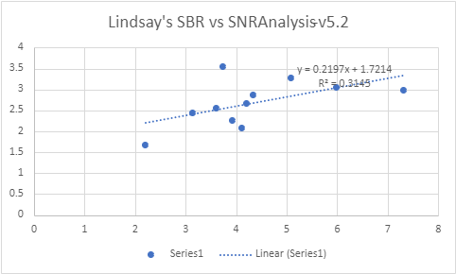
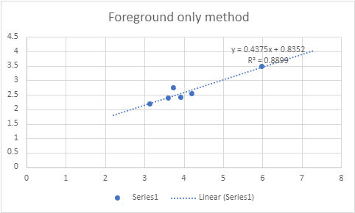
Measurements Comparison
Non-exclusive ( all Maximas)
Foreground only (from 3 experiments of same gene panel)

Slide 8
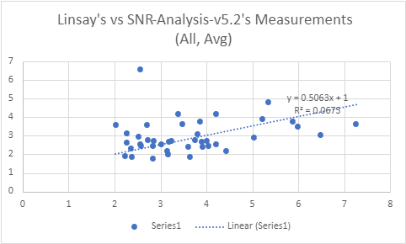
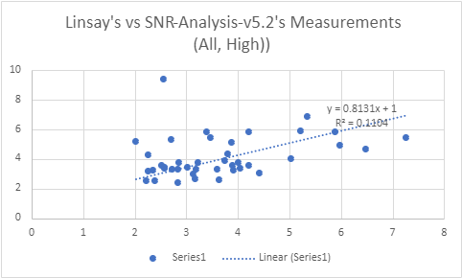
Used an average estimate of SBR by signal vs (Foreground +Background)
Used a higher estimate of SBR by signal vs only Background
Trendline is clearly shown using both estimates- "higher" estimate of spot vs background is closer to our measurements, and more sensitive
Noise is high; sensitivity < 1;
A variety of different experiments in different conditions
Human measurements may be biased, if coming only from 1 person
Note that R2 is not all indicative because we are measuring a narrow range of values.

Slide 9
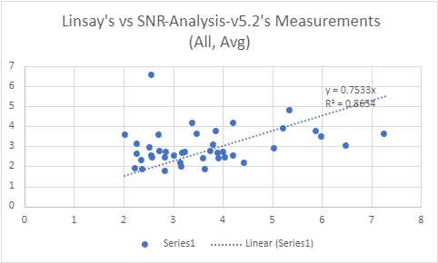
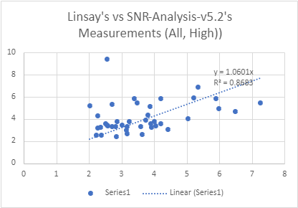
Same graphs, set 0 intercept

Slide 10
Usage
Available on Github
Now performs background subtraction mode if 'bg' or another user-defined folder is available
├───DQS
│ ├───Ctrl
│ │ └───AcqData
│ └───AVM
│ └───AcqData
├───bg (Optional)
│ └───AcqData
└───Cyc01R
├───AcqData
├ SNRAnalysis-v5.1.py
├ SNRA-settings.ini
Just double-click to use!

Slide 11
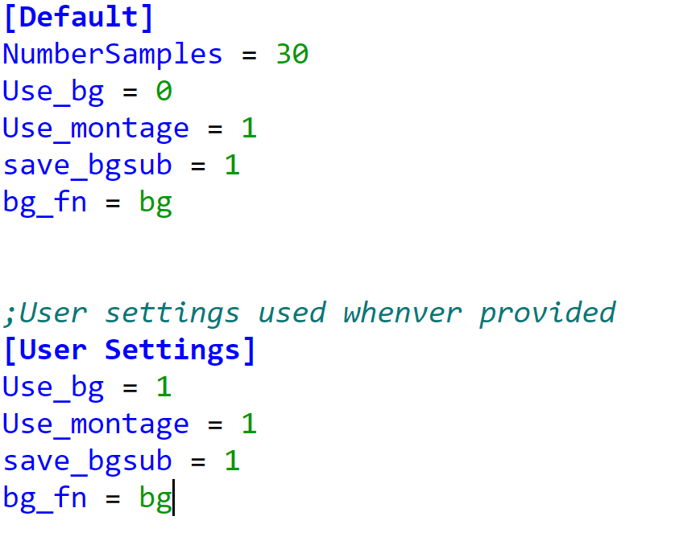
SNRA-settings.ini
If this section is NOT provided, it will use settings from [Default] section settings, where 30 random samples are selected

Slide 12
Results & Output – Analysis Summary
1. Basic Image Info
1
2
2. Foreground filtered ratios
For most "normal" images, this ratio is reliable
3
3. "Collage images"-filtered ratios
More conservative ratio, or if background/artifacts intensity is high
4
3. Background-subtracted spot-finding method ratios

Slide 13
└───SNRAnalysis-Summary
└───Cyc01R
├───AcqData
└───BG-subtracted (Generated)
└───Cyc02R
├───AcqData
└───BG-subtracted (Generated)
…. for each cycle

Slide 14
Code availability
GitHub - supermomo668/Gaussian-Mixture-Fluorescence-In-Situ-Hybridization-Signals-to-Background-Analysis: Biomolecular imaging research
Download ready

